Slide 1

Artificial Intelligence (CSE 412)
Topic – 9A: Introduction - Setting the Context
Department of CSE
Daffodil International University

Slide 2
Topic Contents
Networks of Functions
Synthesis of Boolean Functions
Equivalent Networks

Slide 3
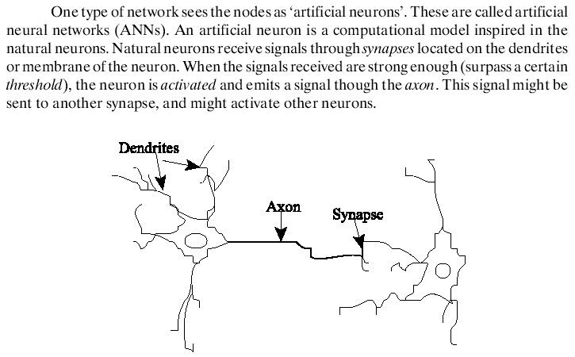
Overview

Slide 4
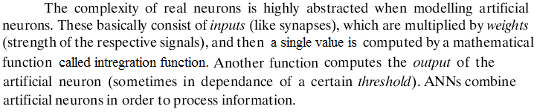
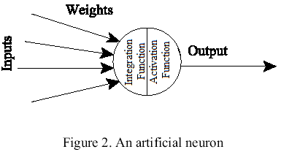
Overview

Slide 5
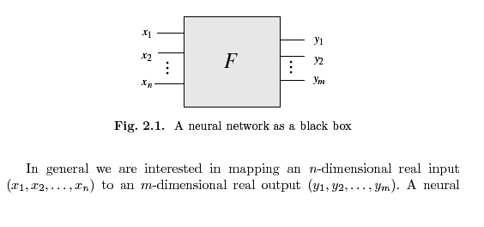

Overview

Slide 6
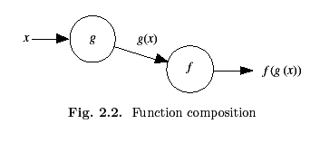
Overview

Slide 7
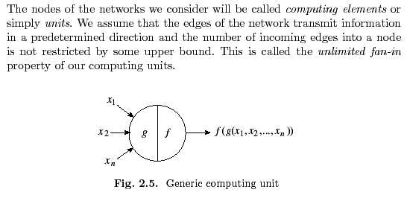

Overview

Slide 8
Applications
The power and usefulness of artificial neural networks have been demonstrated in several applications including speech synthesis, diagnostic problems, medicine, business and finance, robotic control, signal processing, computer vision and many other problems that fall under the category of pattern recognition.
For some application areas, neural models show promise in achieving human-like performance over more traditional artificial intelligence techniques.

Slide 9
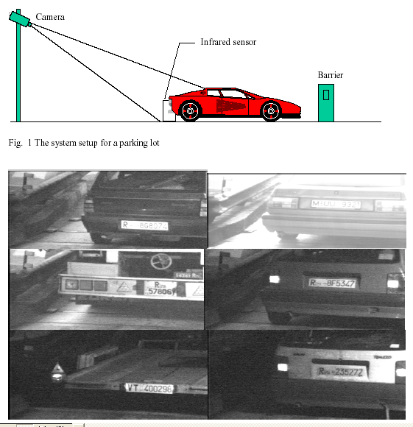
A neural network based artificial vision system for license plate recognition

Slide 10
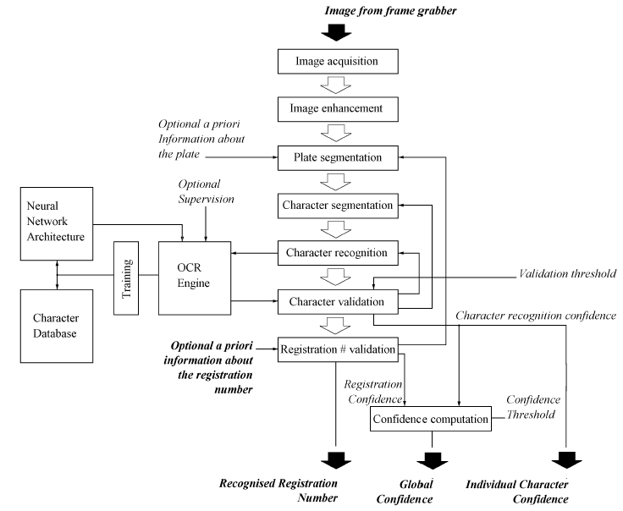

Slide 11
History
The branch of artificial intelligence called neural networks dates back to the 1940s, when McCulloch and Pitts [1943] developed the first neural model.
This was followed in 1962 by the perceptron model, devised by Rosenblatt, which generated much interest because of its ability to solve some simple pattern classification problems.
This interest started to fade in 1969 when Minsky and Papert [1969] provided mathematical proofs of the limitations of the perceptron and pointed out its weakness in computation.

Slide 12
History
The development of more-powerful networks, better training algorithms, and improved hardware have all contributed to the revival of the field.
Neural-network paradigms in recent years include the Boltzmann machine, Hopfield’s network, Kohonen’s network, Rumelhart’s competitive learning model, Fukushima’s model, and Carpenter and Grossberg’s Adaptive Resonance Theory model [Wasserman 1989; Freeman and Skapura 1991].
The field has generated interest from researchers in such diverse areas as engineering, computer science, psychology, neuroscience, physics, and mathematics.

